Slide 1
Student Attendance Project
DIGITAL SYSTEMS PROJECT MANAGEMENT
Tom Amir, Derrek Gass, MINQUAN LI, PAWAN CHANDRA, aaron miller

Slide 2


Presentation Outline
Problem/Solution
System Description
High Level Requirements
Use Case/Class Diagrams
Sample Test Case
System Demo
Future Version
Conclusion

Slide 3

Current Problems
Time consuming
Prone to error
Attendance paper can be misplaced
Lack of organization

Slide 4

Proposed Solution
Web Application (+iOS Application)
Simultaneous check-in
Google spreadsheet report
Time saved

Slide 5

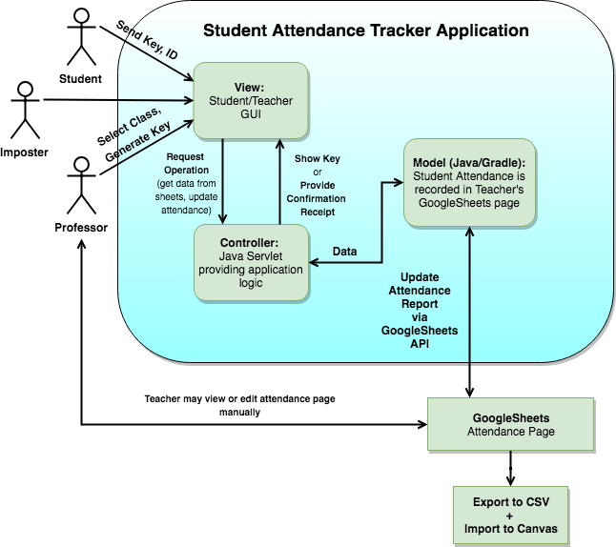



System Description

Slide 6
High Level Requirements
Identifier | Priority | Description
REQ_1 | 2 | The user shall be able to enter their student ID and key and optional comment to log attendance in a particular class
REQ_2 | 4 | The system shall generate a random key for the professor to provide students
REQ_3 | 5 | The system shall verify that the student ID and key match the daily class information.
REQ_4 | 5 | After successfully logging attendance, the system shall provide the student with a receipt for confirmation.
Identifier | Priority | Description
REQ_8 | 3 | Security: System Shall use the SHA256 algorithm to store the teachers password
REQ_9 | 5 | Security: System shall allow daily key to be valid for no longer than 15 minutes.
REQ_10 | 2 | Security: The system shall verify that the student is approximately within (50 feet) of the classroom in the iOS App.

Slide 7
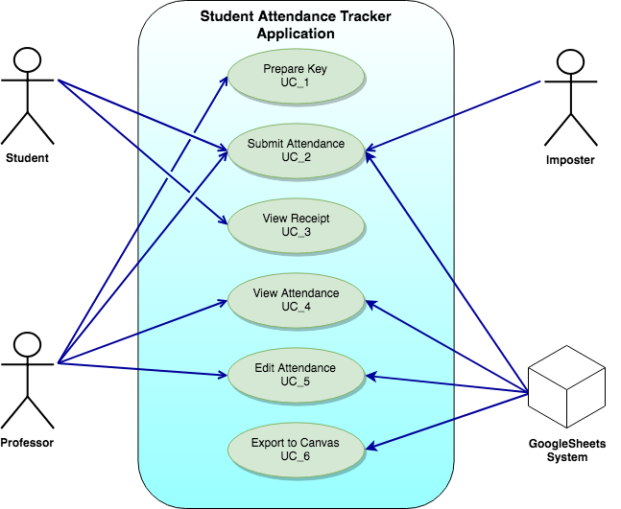
Use Case Diagram

Slide 8
Sample Use Cases
Use Case # | Use Case Name | Use Case Goal
UC_1 | Prepare Key | To set a key for students to enter to prove they were in class.
UC_2 | Submit Attendance | To submit a attendance tracking request for class.

Slide 9
UC_1
Use Case # | Use Case Name | Use Case Details
UC_1 | Prepare Key | <Actor> Instructor <Goal> To set a key for students to enter to prove they were in class. <Pre Conditions> Professor must prepare the key <Post Conditions> 1.Student inputs the key along with other necessary inputs and the attendance is recorded. <Description> The professor prepares a key that needs to be entered in order to submit an attendance tracking request to take roll call. <Sequencing Steps> Professor opens up the attendance application and logs in Professor selects to have a key randomly generated Professor provides the key to the students to input to take at
Details: Teacher opens the attendance application and generates a random key, provided to the students.

Slide 10
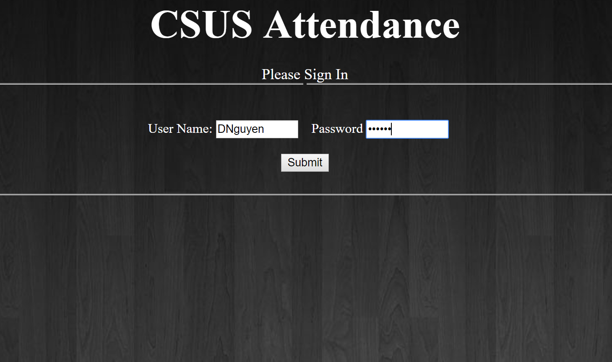
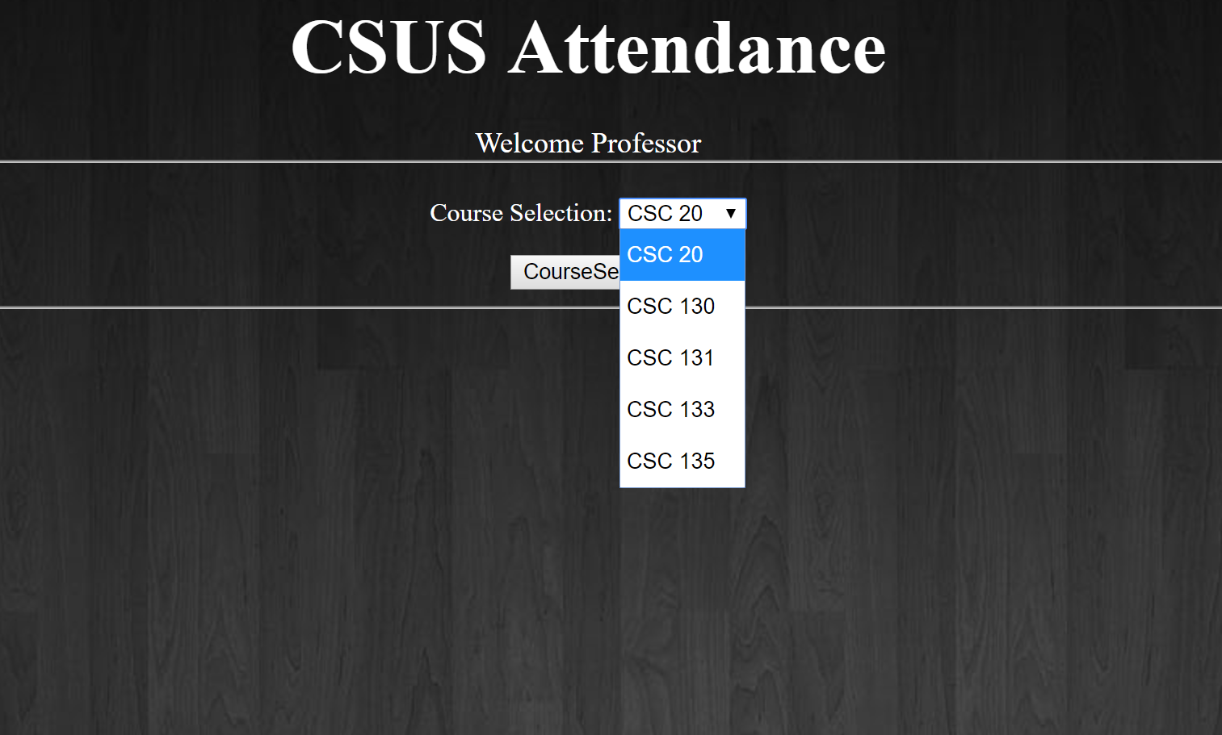
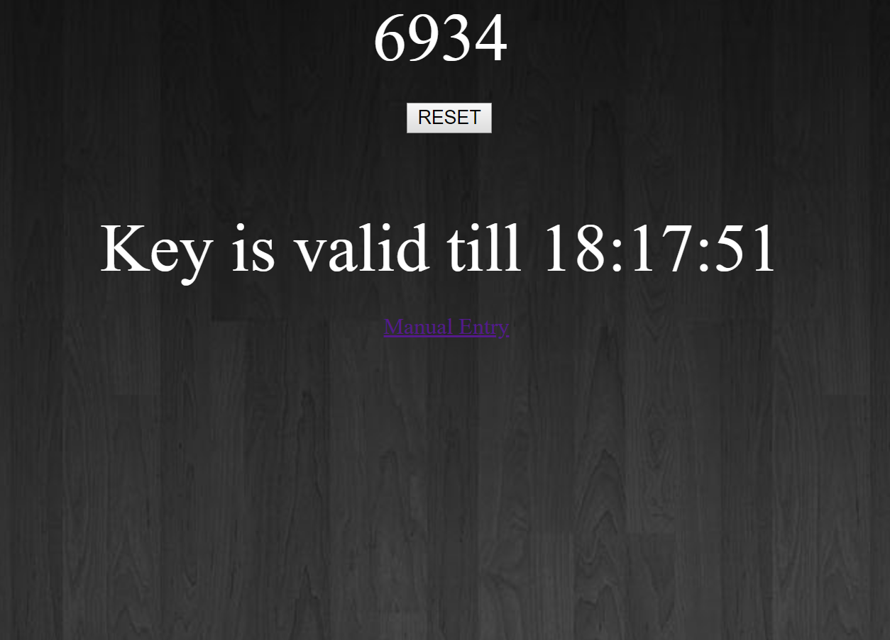
UC_1

Slide 11
UC_2
Use Case # | Use Case Name | Use Case Details
UC_2 | Submit Attendance | <Actors> Student, Google Sheets <Goal> To submit a attendance tracking request for class. <Pre-Condition> Attendance sheet created online. Attendance key was prepared by the professor Attendance key was provided to the students by the professor. <Post Condition> 1.Student gets sent to a confirmation page, acknowledging that the attendance has been recorded. 2. Online attendance sheet has been updated. <Description> This Student, Professor and Intruder can participate in this process. The Professor is the one that sets up the roll call in order for the student or intruder to submit an attendance tracking request. The student submits an attendance tracking request The intruder submits an attendance tracking request <Sequencing Steps> Student opens up the attendance tracking request webpage Professor provides a key for the students to enter in The student is prompted to input the class type, class session, name, and student ID. Student inputs the required information and submits the attendance tracking request. Student is taken to a confirmation page, acknowledging that the attendance has been recorded.
Details: The student signs into attendance application using their ID and given key, before being taken to a confirmation page.

Slide 12
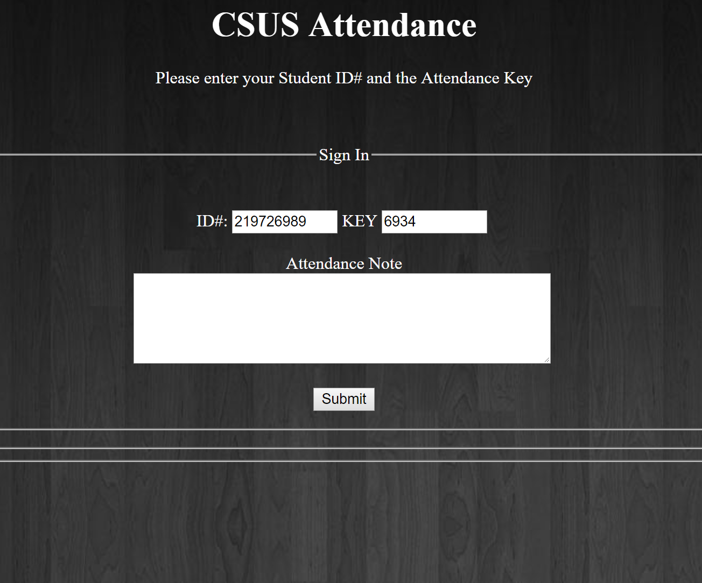
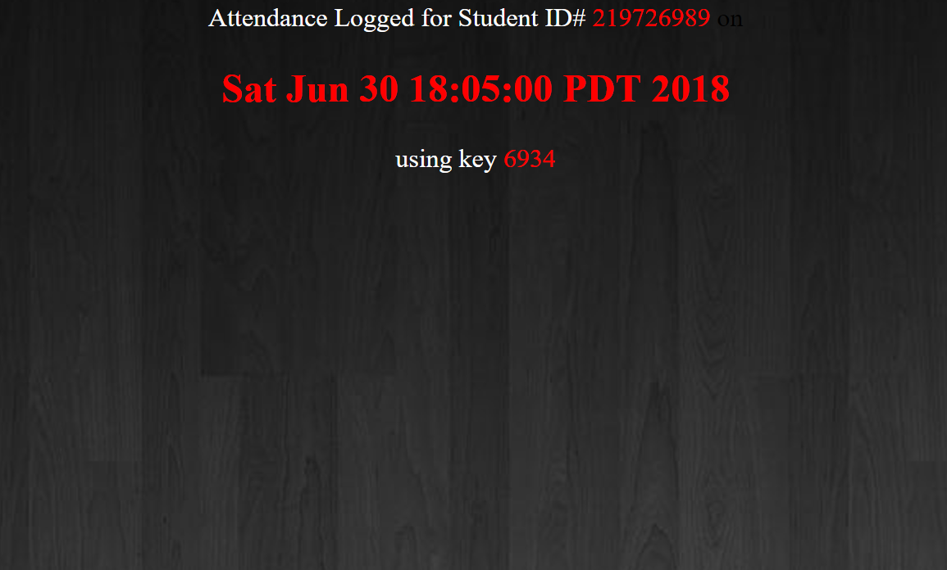
UC_2

Slide 13
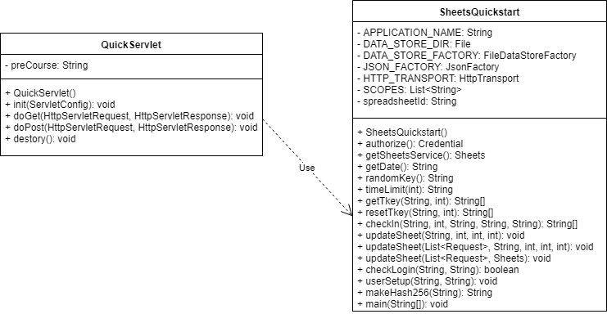
Class Diagram (Servlet)

Slide 14
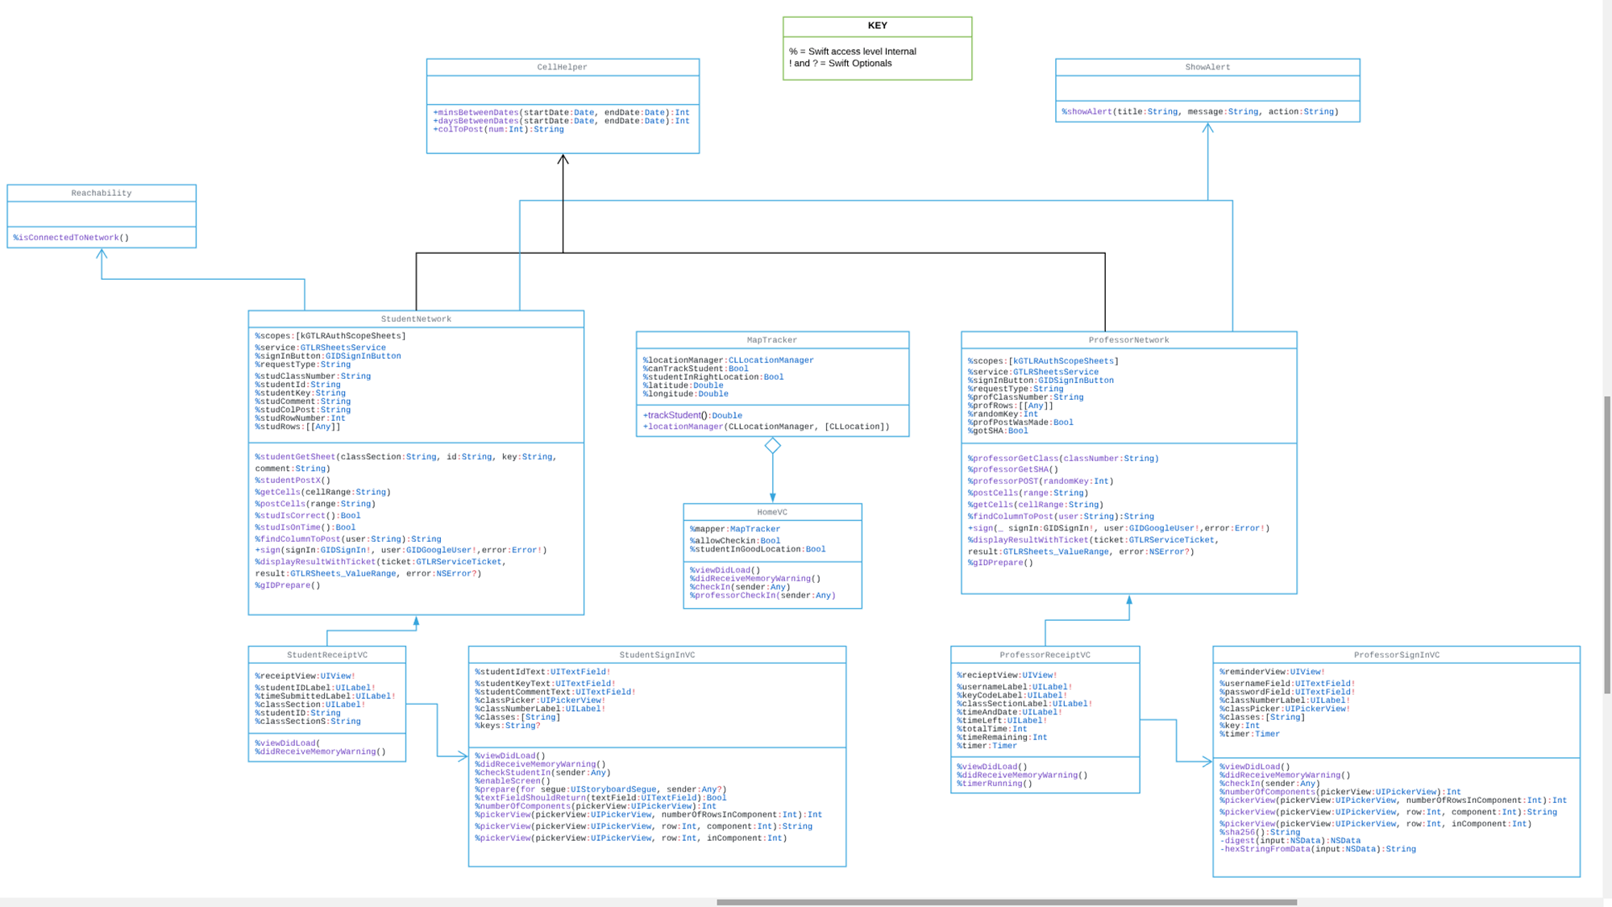
Class Diagram (iOS)

Slide 15
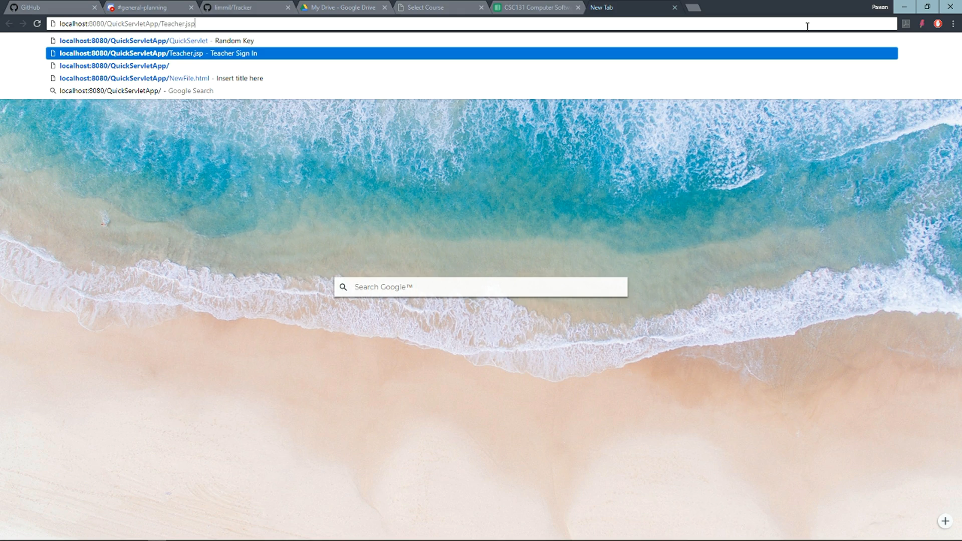
Web Application Demo

Slide 16
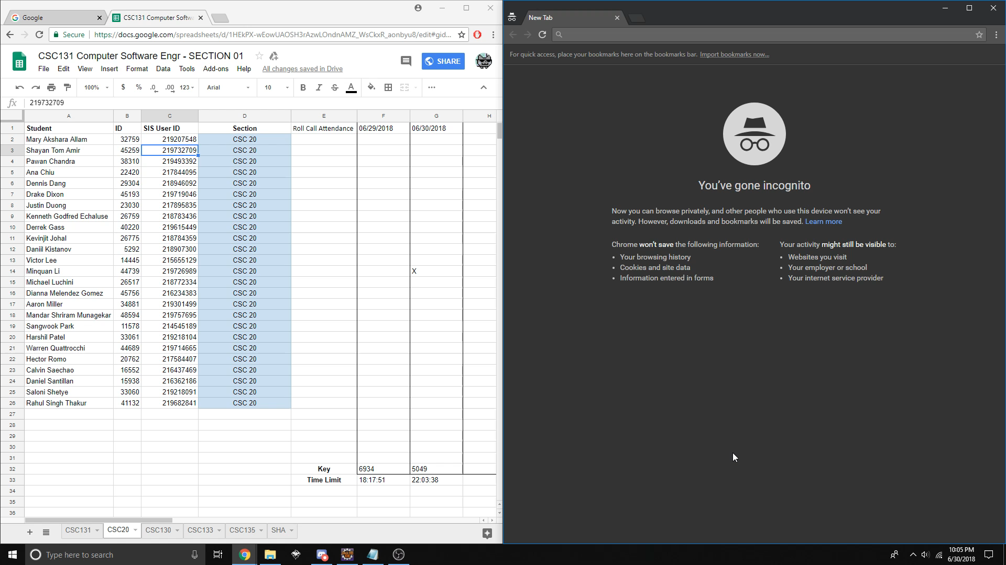
Timer Demo

Slide 17
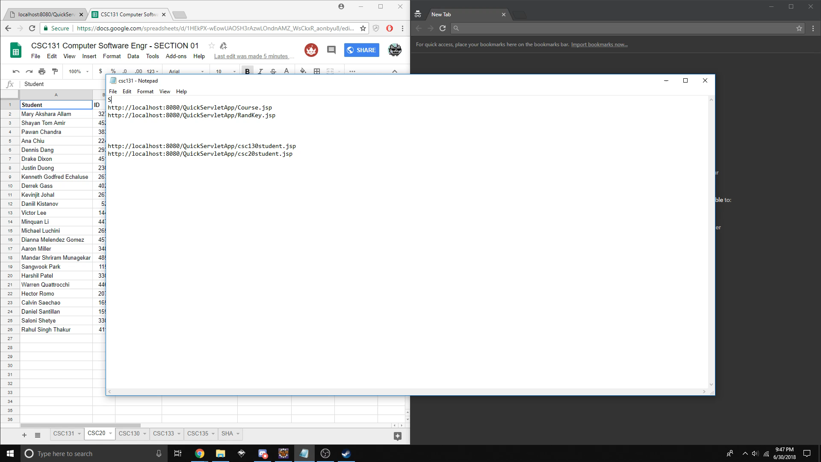
Security Demo

Slide 18

Future Versions/Update
iOS:
Canvas integration
Android version
Accessibility
Servlet application:
Geolocation verification
Canvas integration
Student attendance warnings

Slide 19

Conclusion
What We Learned:
Effective project management
Experience with incremental design
High level documentation
Different technologies:
HTTP protocol
Apache Tomcat
Git (Version Control)
Google Sheets API

